Slide 1
Capacity Building of Rural Women in Climate Information:
Bridging the Gap Between Climate Science and Local Level Climate Adaptation Needs in Himalaya
Professor Prakash C. Tiwari
Senior Fellow
Indian Council of Social Science Research [ICSSR]
Department of Geography Kumaun University, Nainital
Email: pctiwari@gmail.com

Slide 2
Why Himalaya?
It constitutes the Headwater of South Asia
Water and other ecosystem services sustain more than 45% global population in the densely populated plains of South Asia
People of South Asia has access to less than 5% of the global freshwater resources, and per capita water availability is between 1240 and 1730 Cubic Meter/Person/Year which further declining
The rapidly changing climatic conditions in Himalaya will have enormous implications ranging from water, food, livelihood and health security to inter-state conflicts

Slide 3
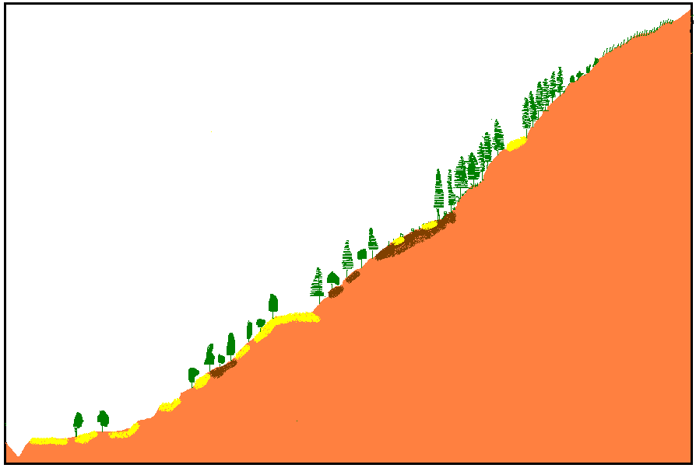
Farming, Food and Livelihood System Along the Himalayan Transacts
5000 m
Transhumance Based Livestock Rearing
Medicinal Plants,
Potatoes, Beans
Great Himalayan Mountains
Alpine
Zone
Intensive
Grazing
Alpine Zone with Sparse Population
4000 m
Transhumance Based Livestock Rearing,
Traditional Food Crops including wheat and buck wheat,
Potatoes
Sub-Alpine Mountains, Sparse Population, Extensive Cultivation, Livestock Grazing
Sub Alpine Mountains with Sparse Population
3000 m
Subsistence Framing with
Livestock and Wheat,
Upland Paddy, Maize,
Millets, Pluses
Mid Temperate Slopes, Mixed Himalayan Forests, Acute Water Scarcity, High Population Density Extensive Cultivation, Horticulture, Vegetable Farming
Middle Temperate Slopes with High Population Density
Lesser Himalaya
Mountains
2000 m
T3
Intensive Framing with
Livestock and Wheat,
Upland Paddy,
Maize, Millets, Pluses
Lower
Temperate
Zone
With High Population Density
Lower Temperate Zone, Mixed Forests, Water Scarcity, High Population Density, Intensive Cultivation
1000 m
T3
Sub-Tropical Zone, Deciduous Forests, High Population Density Intensive Cultivation
Siwalik
Hills
T2
Sub-Tropical Zone
with very Densely Populated River Terraces
[Intensive Irrigated Farming of Paddy, Wheat, Pulses, Potatoes, Oilseeds, Vegetables
T1
500 m

Slide 4
The Spatial Scale of Climate Change Adaptation Governance
Sustainable Development Goals
Global Climate Models
Regional Climate Models
National Plans
State Plans
Local
Needs
Global
Regional
National
State level
Local Level
Mainstreaming Climate Change Adaptation and DRR
District
Development Block
Watershed
Policy Decision
Policy Decision
Implementation
Climate Change Adaptation Governance Policies and Action Plans
Geo-Climatic Complexities
Local Level [Plan Implementation, Government Line Departments, Water, Irrigation, Agriculture, Public Work, Health, Horticulture, Tourism]
Village Level [Community-based Institutions, Natural Resource Development and Utilization, Gender Norms, Equity, Justice]
Household Level [Traditional Knowledge]
Risk
Vulnerability
Adaptive Capacity
Impact, Decision and Response

Slide 5
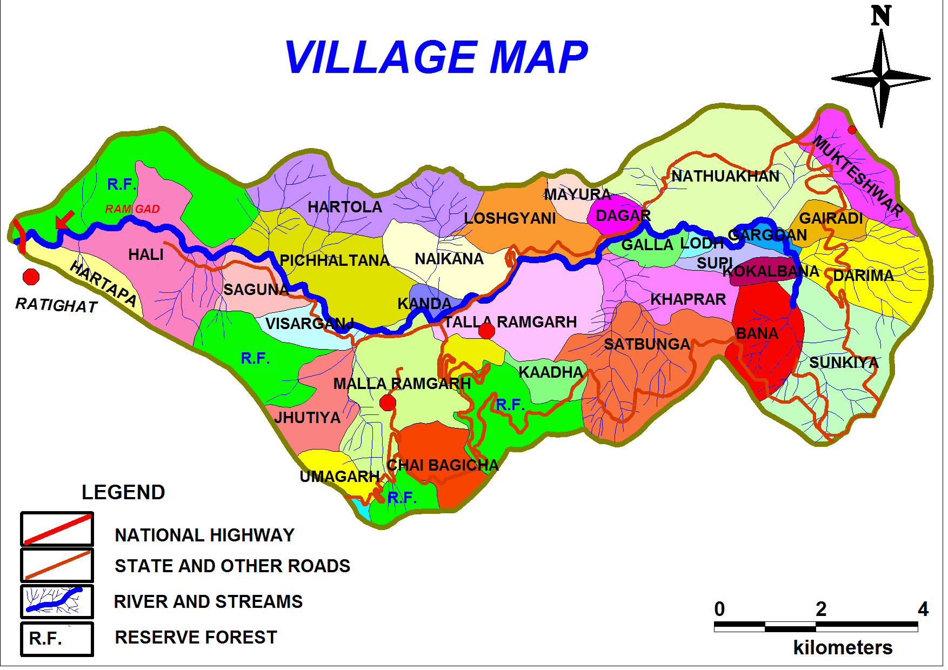
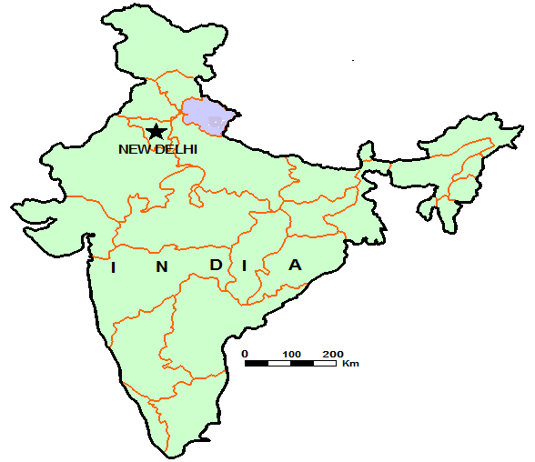
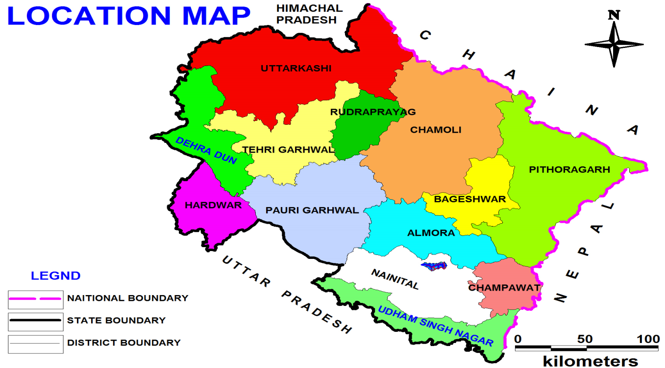
Ramgad Watershed: Kumaon Lesser Himalaya
[Community Based Climate Monitoring]
Bohrakot
Automated Weather Station
Manual Weather Station

Slide 6
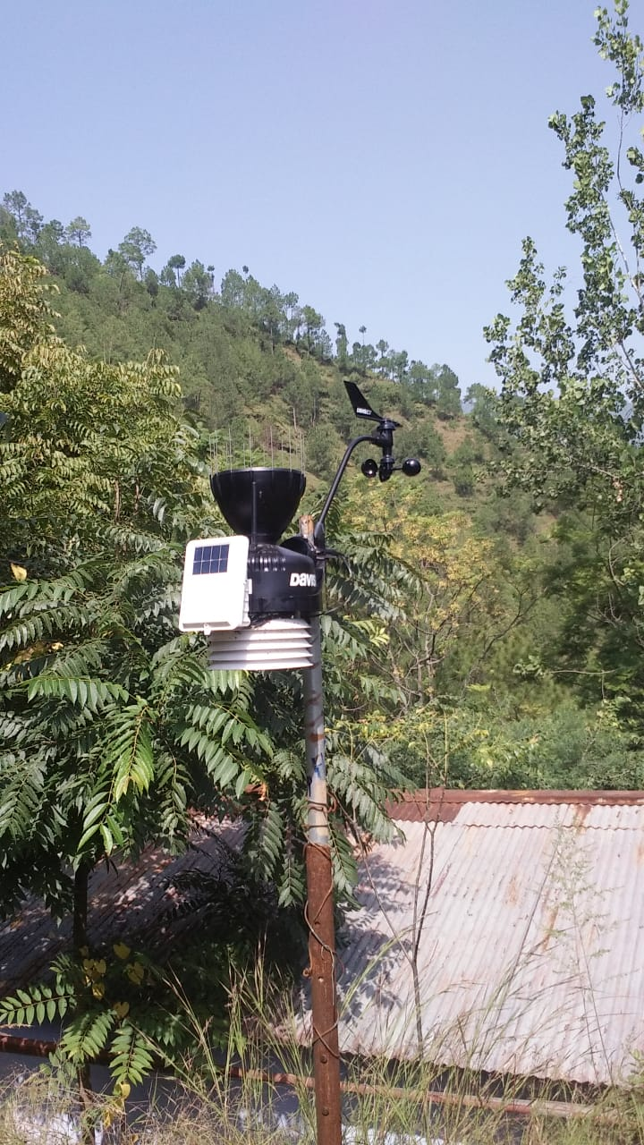
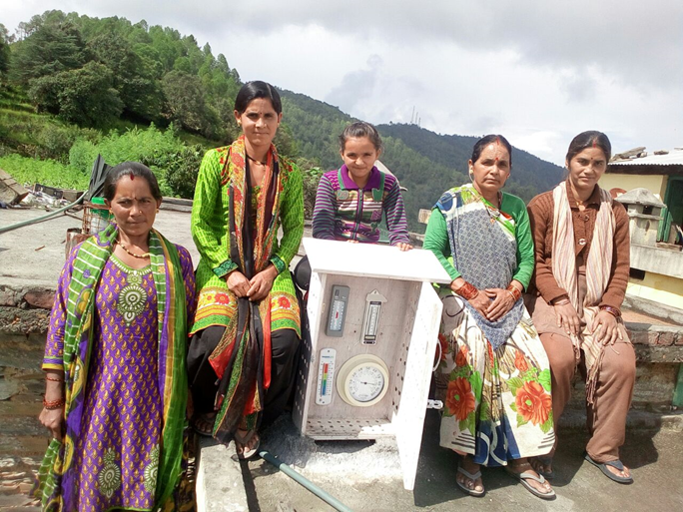
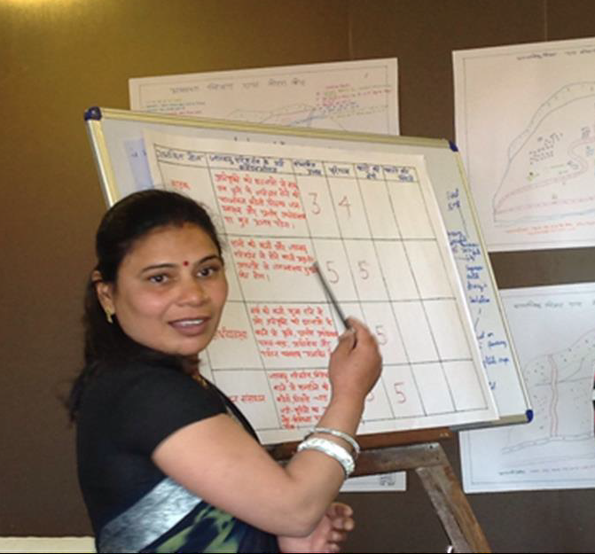
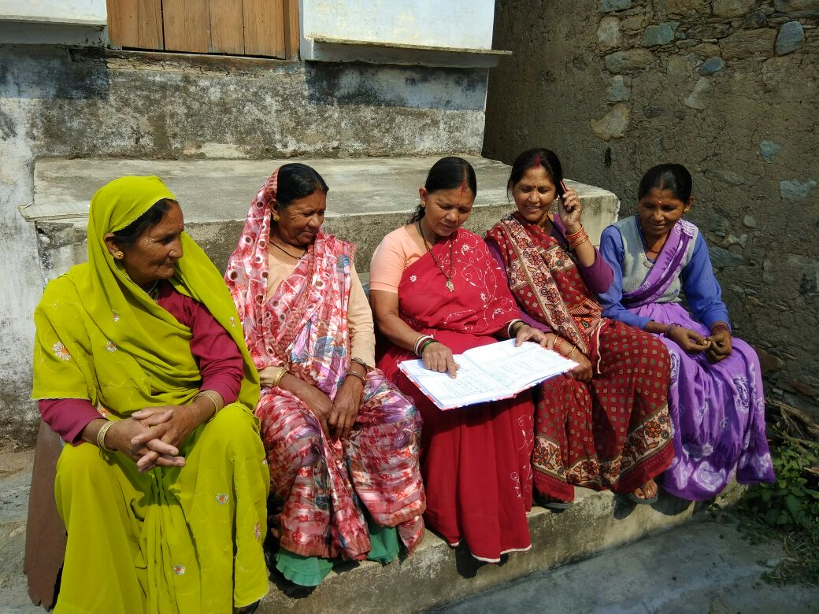
Local Level Climate Information:
Making Climate Science Community and Women Centric
Village Councils
[Village Panchayats]
Meetings and Consensus Building and Identification of Villages
Forest Councils
[Forest Panchayats]
Local Level Government Line Departments
Identification of Sites for Installation of Weather Equipment
Observation, Recording , Sharing and Dissemination
[SMS]
Flash Flood Early Warning
Identification
of Institutional Mechanism
Block Development
Officer [Nodal Point]
Installation of Weather Equipment in identified Villages
Non -Governmental Organizations
Civil Society Organizations
Training of Community Members and Other Stakeholders
Youth Clubs, Schools, Women’s Associations

Slide 7
Local Institutions: Key Actors in Shaping Vulnerability and Risk, Mobilizing Community, Resources, Information, Knowledge and Technology
Local Institutions
Government
Institutions
Community-based Institutions
Private Institutions
[Private Business Enterprises]
Local Bodies
[Panchayat Raj Institutions]
Local Government Line Departments
[Forest, Irrigation, Water Supply, Agriculture, Livestock, Health, Irrigation, Public Work]
Municipal Councils
Gram Panchayats
Block Development Committees
Forest Councils
Mahila Mangal Dals
CSOs
NGOs
Youth Clubs
Self Help Groups
Religious and Charity Organizations
Mountain people have developed distinctive mechanisms to cope with natural risks by forming a range of institutions
It is necessary to identify and map local institutions and strengthen them through their capacity building
Improve community access to local institutions
Facilitate vertical as well as horizontal coordination among the institutions

Slide 8
What its Contribution?
This is improving the perception, visualization and response mechanism of local communities specifically women to climate change,
Improving community access to knowledge, information, technology and
Empowering local communities in climate information and services
Setting an illustration of communicating climate science to communities and facilitating Community-based Adaptation (CbA)
Sensitizing communities about the importance of climate information in local level adaptation

Slide 9
Thanks!

